Slide 1
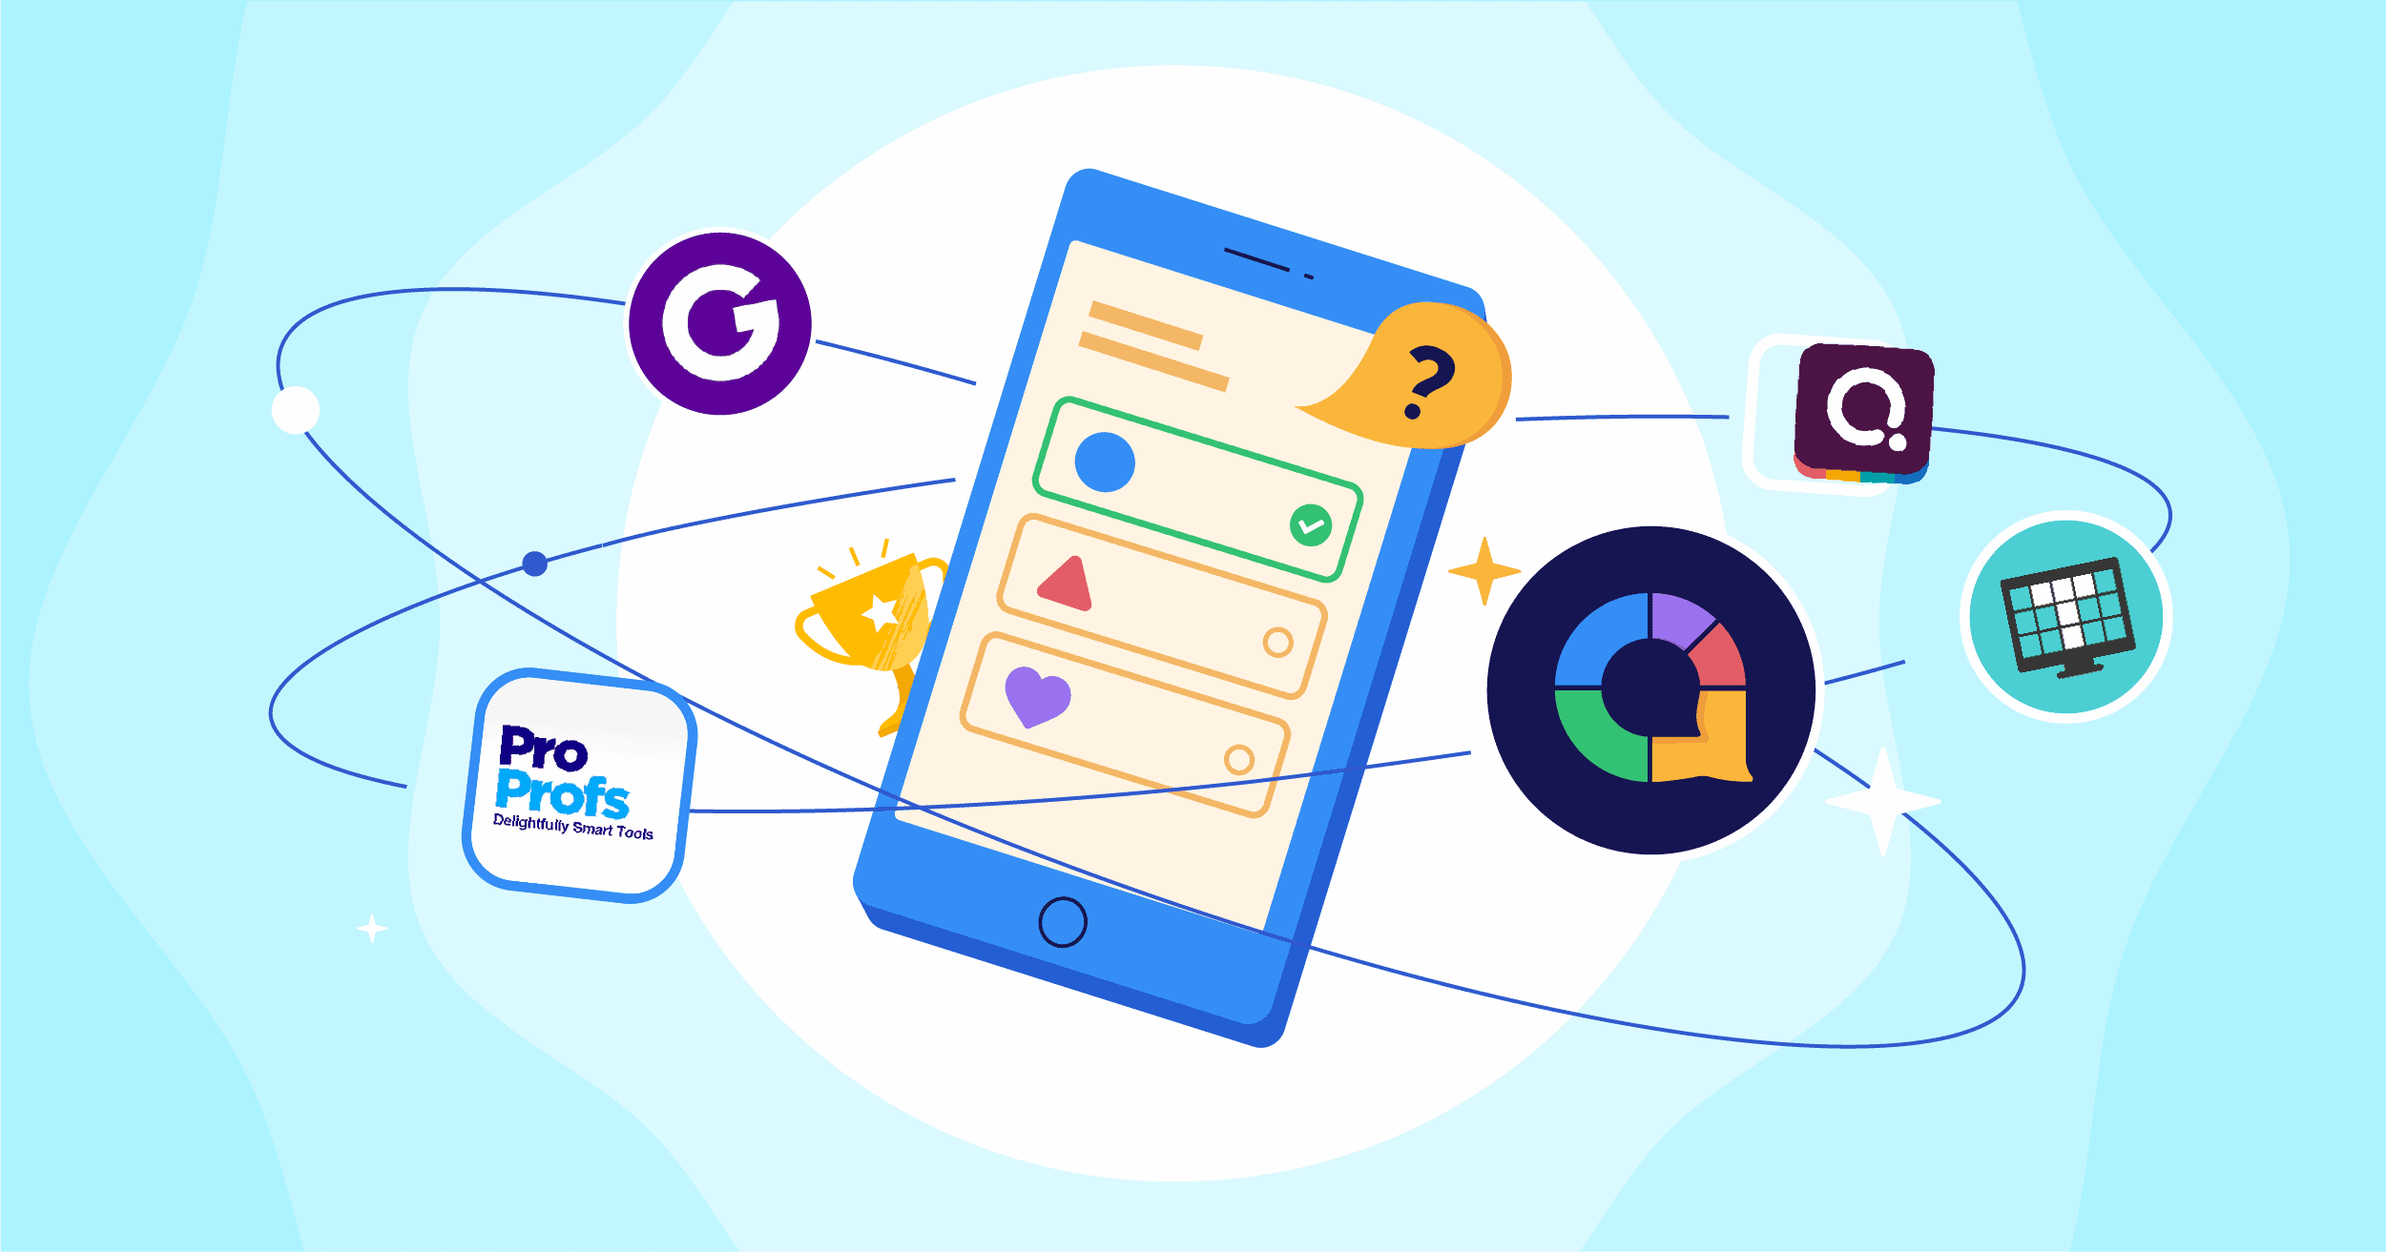
Quiz Application
Prepared by Hannen, Nabeel & Iwin

Slide 2

Introduction
In the landscape of technological advancements, a dynamic and user-friendly quiz application crafted using the power of Python. With a seamless interface and robust functionality, Quiz application aims to revolutionize the way we approach quizzes, making learning both enjoyable and accessible for everyone.

Slide 3

OBJECTIVE
Our objective is to develop a Python-based quiz application that not only promotes interactive learning but also fosters engagement and retention among users. By providing a seamless and intuitive platform, we aim to enhance the educational experience, catering to various learning styles and preferences. Through personalized quizzes and comprehensive feedback mechanisms, our application seeks to foster a stimulating environment that encourages users to expand their knowledge and skills across diverse subject areas. Our goal is to make learning both accessible and enjoyable, fostering a passion for continuous education and growth.

Slide 4

TECHNICAL OVERVIEW
Our quiz application, developed using Python's graphical user interface (GUI) capabilities, offers an intuitive and interactive platform for users to engage in educational quizzes. Leveraging the Tkinter library, we have created a seamless and visually appealing user interface that facilitates smooth navigation and an enhanced user experience.

Slide 5
START
Fetch questions from Open Trivia DB API
QuizInterface
Pass Quiz Object to QuizInterface
Create a Question object for each fetched question
Open Trivia DB API – Questions
Append Question objects to question bank list
User Interacts with the Quiz
Pass question_bank to QuizBrain
Create Quiz Object
END

Slide 6
APPLICATION OVERVIEW
01
02
03
04
Question Fetching:
Question Handling:
Quiz Initialization:
User Interaction:
Quiz app initiates by fetching questions from the Open Trivia DB API.
Each question is encapsulated in a Question object and added to the question bank list.
The question bank is passed to the Quiz Brain, creating a quiz object to manage the quiz's logic.
The Quiz Interface allows users to navigate through the quiz, answering questions, and receiving instant feedback

Slide 7
APPLICATION OVERVIEW
01
02
03
04
Question Fetching:
Question Handling:
Quiz Initialization:
User Interaction:
Quiz app initiates by fetching questions from the Open Trivia DB API.
Each question is encapsulated in a Question object and added to the question bank list.
The question bank is passed to the Quiz Brain, creating a quiz object to manage the quiz's logic.
The Quiz Interface allows users to navigate through the quiz, answering questions, and receiving instant feedback

Slide 8
APPLICATION OVERVIEW
01
02
03
04
Question Fetching:
Question Handling:
Quiz Initialization:
User Interaction:
Quiz app initiates by fetching questions from the Open Trivia DB API.
Each question is encapsulated in a Question object and added to the question bank list.
The question bank is passed to the Quiz Brain, creating a quiz object to manage the quiz's logic.
The Quiz Interface allows users to navigate through the quiz, answering questions, and receiving instant feedback

Slide 9
APPLICATION OVERVIEW
01
02
03
04
Question Fetching:
Question Handling:
Quiz Initialization:
User Interaction:
Quiz app initiates by fetching questions from the Open Trivia DB API.
Each question is encapsulated in a Question object and added to the question bank list.
The question bank is passed to the Quiz Brain, creating a quiz object to manage the quiz's logic.
The Quiz Interface allows users to navigate through the quiz, answering questions, and receiving instant feedback

Slide 10

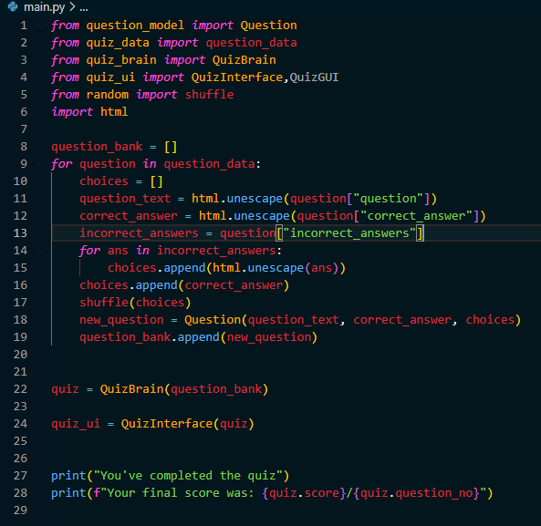

Slide 11
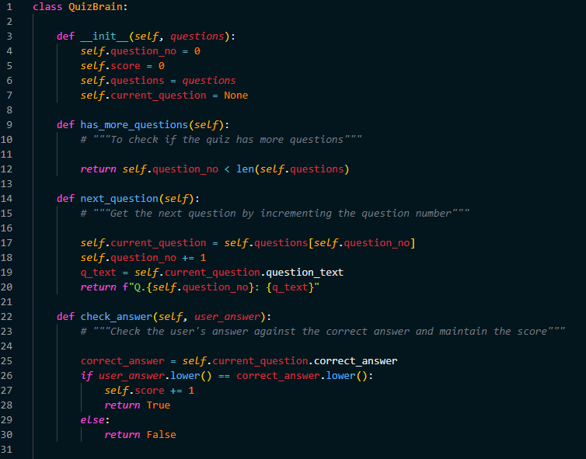

Slide 12
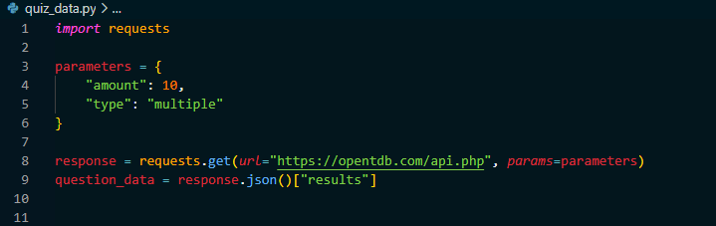

Slide 13
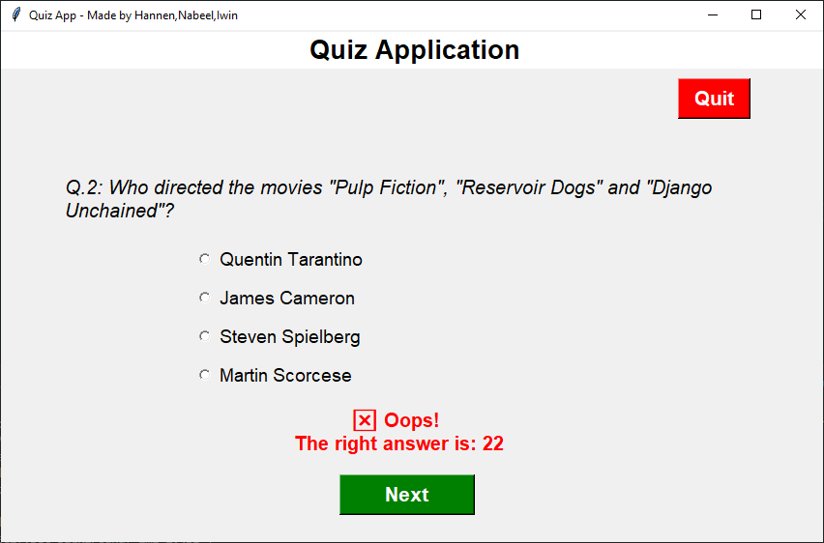
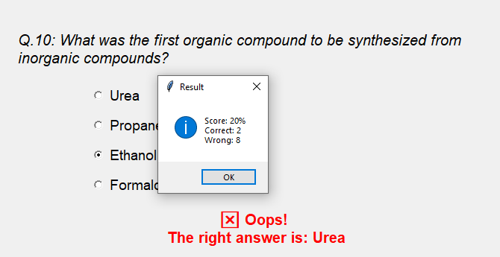

Slide 14
SCOPE
01
03
04
Implement user authentication and profiles to enable multiple users to track their quiz progress independently. This could include features like user registration, login, and personalized dashboards.
Implement adaptive learning algorithms that analyze user performance and dynamically adjust the difficulty of questions to match the user's proficiency level. This can enhance the educational effectiveness of the application.
Extend the reach of your quiz application by developing a mobile version. This can be achieved through responsive design or by creating a dedicated mobile application for iOS and Android platforms.

Slide 15
SCOPE
01
02
03
04
Implement user authentication and profiles to enable multiple users to track their quiz progress independently. This could include features like user registration, login, and personalized dashboards.
Introduce a leaderboard system to track and display high scores. Consider integrating social media sharing functionality to allow users to share their achievements with friends, promoting healthy competition.
Implement adaptive learning algorithms that analyze user performance and dynamically adjust the difficulty of questions to match the user's proficiency level. This can enhance the educational effectiveness of the application.
Extend the reach of your quiz application by developing a mobile version. This can be achieved through responsive design or by creating a dedicated mobile application for iOS and Android platforms.

Slide 16
SCOPE
01
02
03
04
Implement user authentication and profiles to enable multiple users to track their quiz progress independently. This could include features like user registration, login, and personalized dashboards.
Introduce a leaderboard system to track and display high scores. Consider integrating social media sharing functionality to allow users to share their achievements with friends, promoting healthy competition.
Implement adaptive learning algorithms that analyze user performance and dynamically adjust the difficulty of questions to match the user's proficiency level. This can enhance the educational effectiveness of the application.
Extend the reach of your quiz application by developing a mobile version. This can be achieved through responsive design or by creating a dedicated mobile application for iOS and Android platforms.

Slide 17
SCOPE
01
02
03
04
Implement user authentication and profiles to enable multiple users to track their quiz progress independently. This could include features like user registration, login, and personalized dashboards.
Introduce a leaderboard system to track and display high scores. Consider integrating social media sharing functionality to allow users to share their achievements with friends, promoting healthy competition.
Implement adaptive learning algorithms that analyze user performance and dynamically adjust the difficulty of questions to match the user's proficiency level. This can enhance the educational effectiveness of the application.
Extend the reach of your quiz application by developing a mobile version. This can be achieved through responsive design or by creating a dedicated mobile application for iOS and Android platforms.

Slide 18

Conclusion
the development of the quiz application using Python with the Tkinter graphical user interface has proven to be a rewarding and enriching project. The application seamlessly integrates with the Open Trivia DB API to fetch a diverse set of questions, encapsulates them using a robust Question class, and organizes them into a structured question bank. The QuizBrain engine efficiently manages the quiz logic, ensuring a smooth flow from question to question, calculating scores, and providing an engaging user experience. The Tkinter-based QuizInterface adds an intuitive and visually appealing layer, allowing users to interact with the quiz effortlessly. Looking ahead, there is ample room for future enhancements, such as multi-user support, customizable quizzes, and integration with learning management systems, to further elevate the educational value and user engagement of the quiz application. Overall, this project has not only showcased the capabilities of Python and Tkinter but has also laid the foundation for a dynamic and scalable quiz application that caters to a diverse audience and promotes interactive learning.

Slide 19


